Slide 1
Brief Description of
Facebook Stock
Junling Gao | 001839851 Wenqing Liang | 001873144 Ashish Kumar | 001497334
Tripti Santani | 001497382 Dipti Bhattad | 001831210. Ameya Deshmukh | 001401980

Slide 2
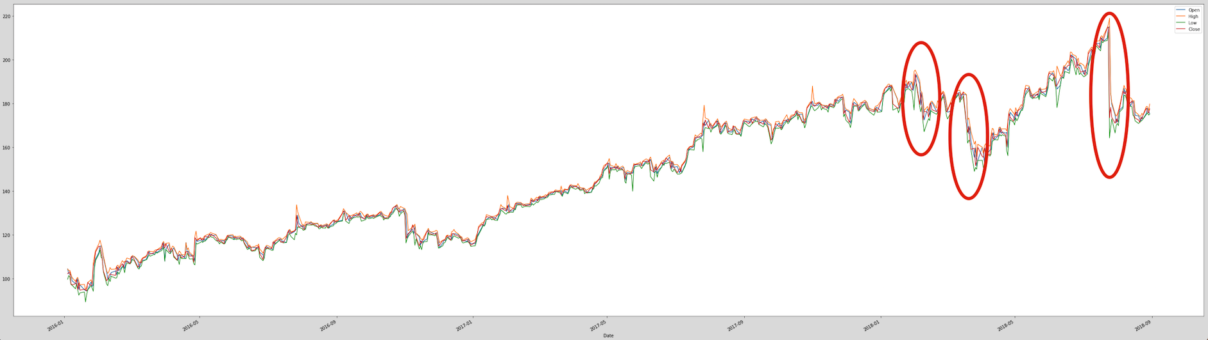
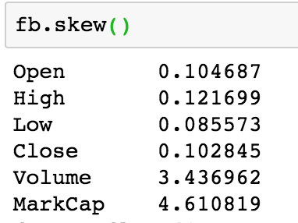
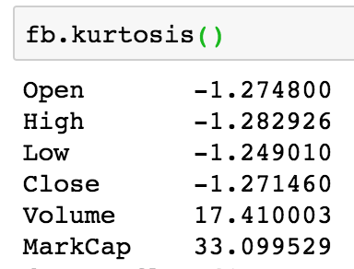
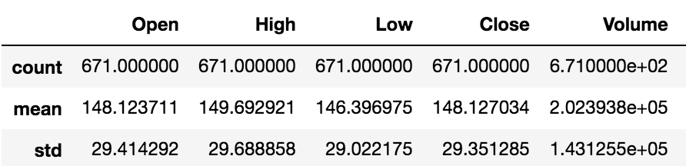
Background
Before 2018
Event I
Cambridge Analytica
Scandal
Facebook reports Q2 earnings
Facebook’s share price is growing steadily and rapidly
Zuckerberg says that users spent less time on the platform
50 million accounts revealed to have been compromised by Cambridge Analytica
Total revenue-growth rates will continue to decelerate in the second half of 2018

Slide 3
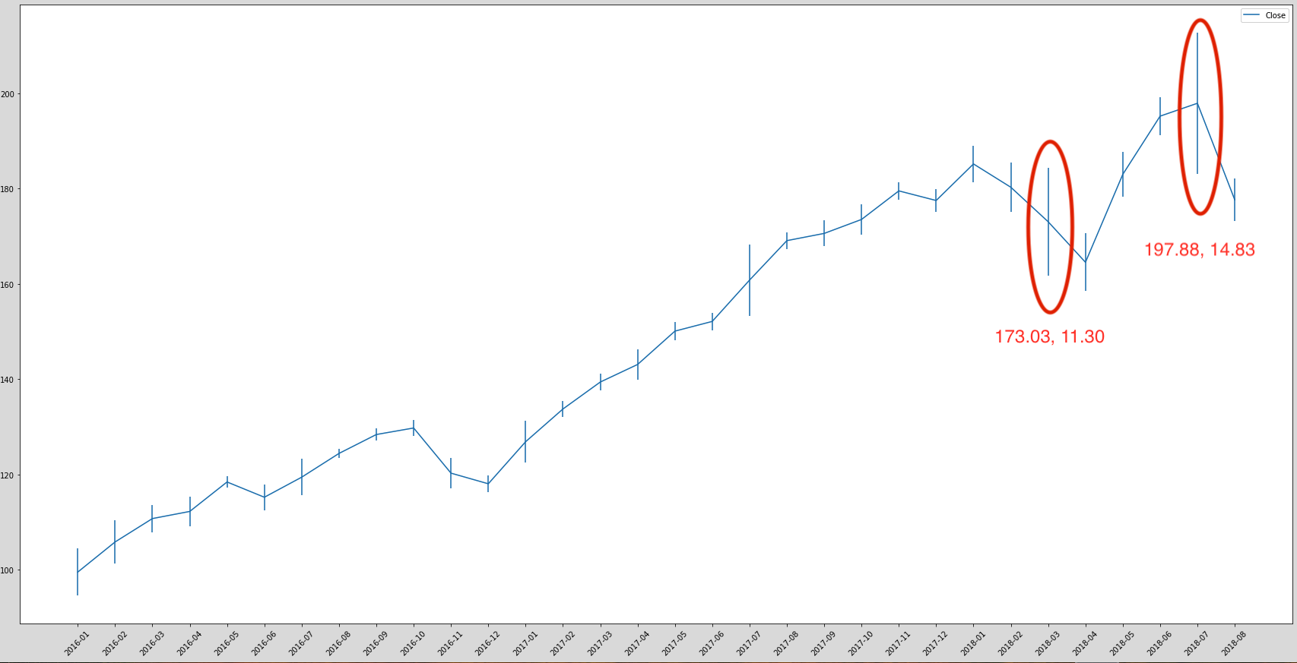
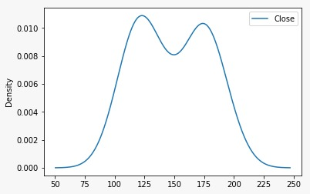
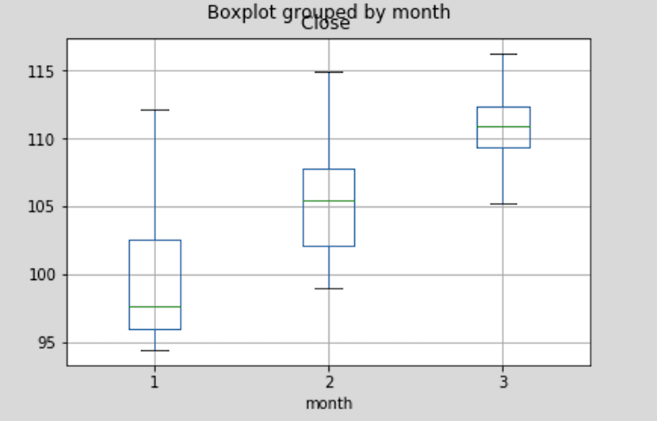
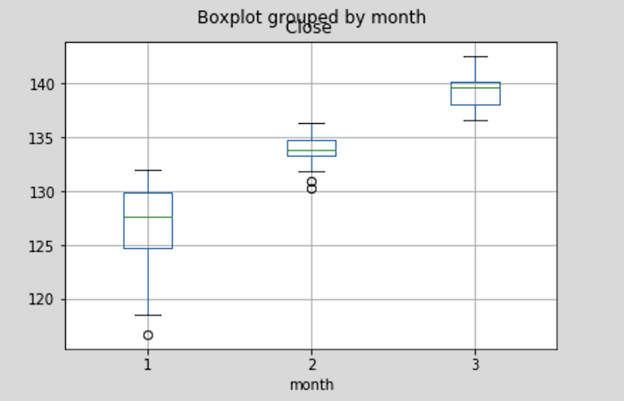
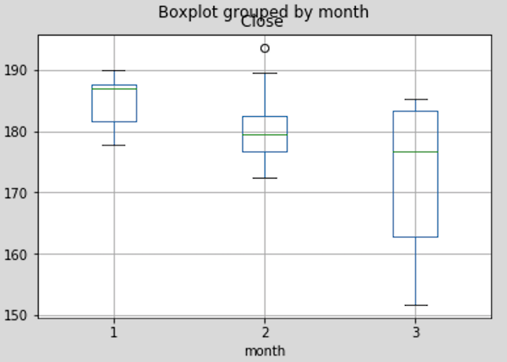
Stock Price -- Closing
Monthly Mean with Std
Density Plot
2016 Q1
2017 Q1
2018 Q1

Slide 4
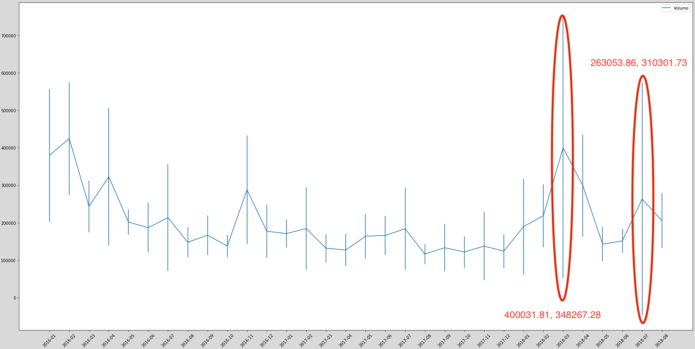
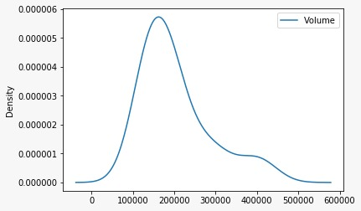
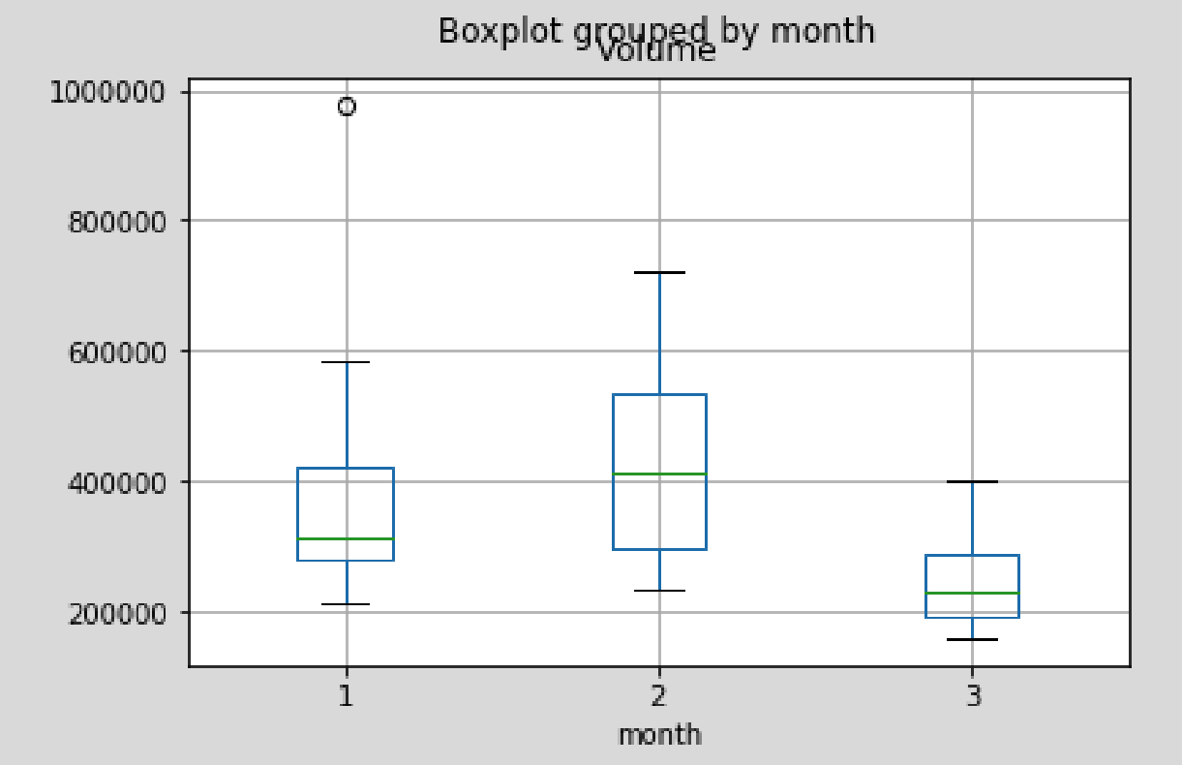
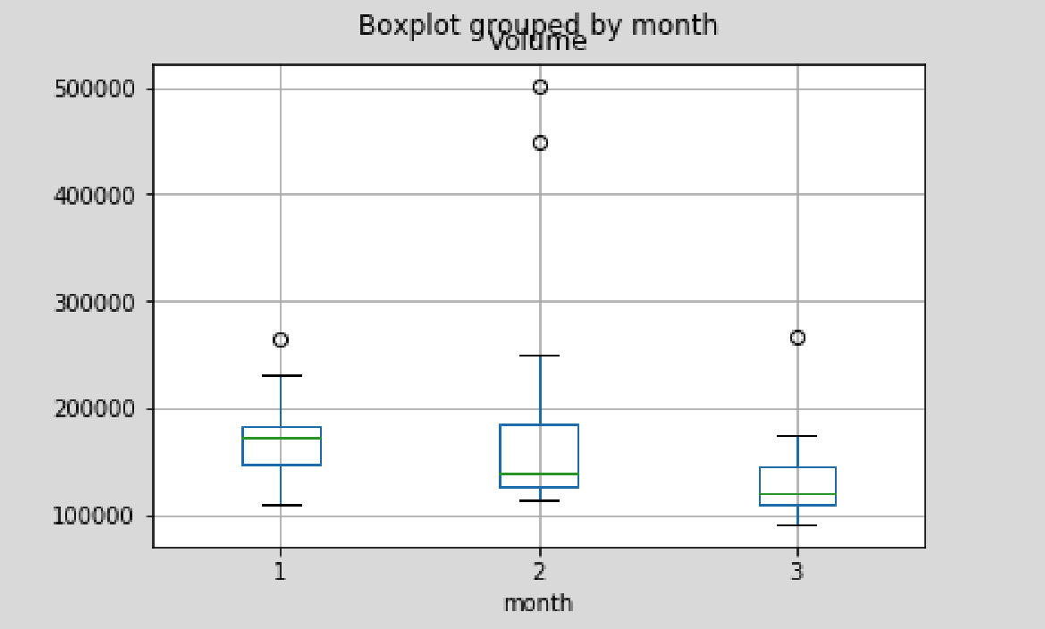
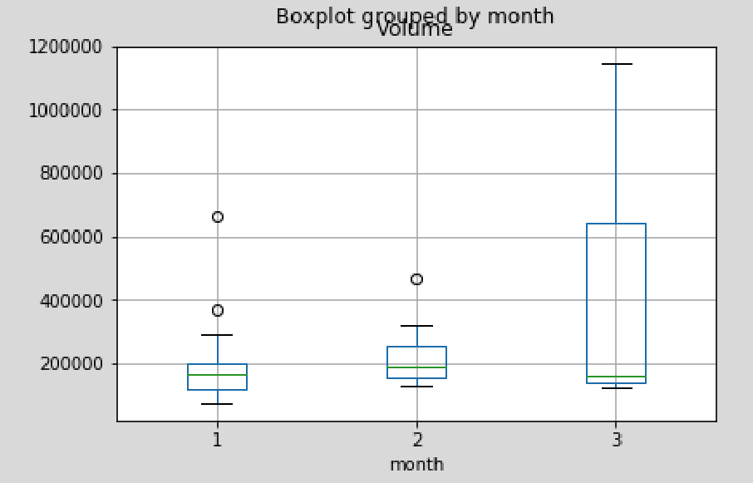
Stock Volume
Monthly Mean with Std
Monthly Mean with Std
Density Plot
2016 Q1
2017 Q1
2018 Q1

Slide 5
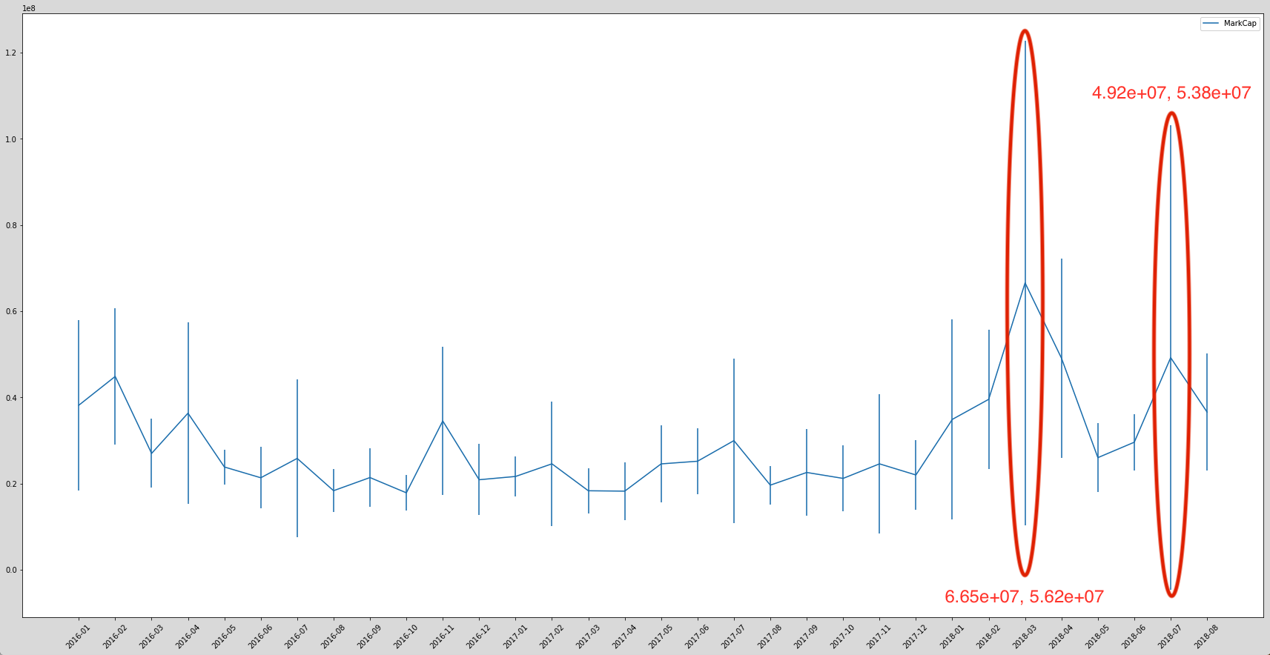
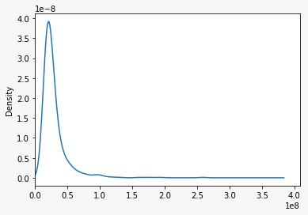
Market Capitalization: Closing Price x Volume
Monthly Mean with Std
Density Plot

